Slide 1
Part 1: Introduction
© 2021 Frank Gray
Notes:
PURPOSE: To demonstrate that we should not focus solely on imparting Knowledge. We also need to seek ways of building relationships as well as meeting people at their point of (real, felt) need. When we begin to understand where a person is in their spiritual pilgrimage we are in a better position to speak with them in a meaningful way – that they will understand and appreciate.
OUTCOMES:Students will be able to:
1. Draw a Matrix and explain it simply
2. Describe how to position where a specific audience is located
3. Explain why different programs or content are needed according to where audience is positioned on Matrix
4. Describe some basic questions that can be asked to help position a specific audience on Matrix

Slide 2
What it is good for...
For finding out where people are on their spiritual pilgrimage
For diagnosing how well our current ministries are hitting – or missing – the mark
For planning a balanced set of ministries (knowing our audience)
For understanding the importance of relationship in communicating the message.

Slide 3
Meeting people where they are at on their faith journey
Spiritually
Do they know about God?
What do they know and understand (about God and Gospel)?
What do they think they know – and misunderstand (about God and Gospel)?
How do they feel towards God, Jesus, the Gospel, Christians – and Church?
Are they open to Change?
What problems do they face in daily life – family, work, relationships, etc.?
What are their interests and pastimes?
Notes:
Meeting people where they are at is perhaps the most important thing we can learn from (The Gray Matrix) TGM. This understanding has many dimensions. Here are some of the main ones. Each is worthy of discussion in specific contexts.

Slide 4
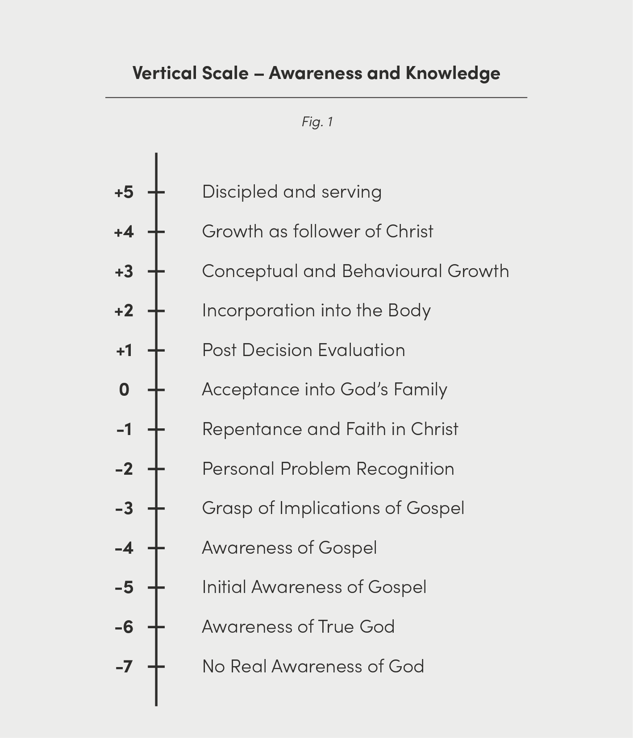
Knowledge – or Spiritual Awareness
People generally start with “No real awareness of God “ (-7)
As they receive input their knowledge of the Gospel increases (-6 to -2)
By God’s grace they understand Repentance & Faith (-1) – and act on it
They begin to grow in knowledge and love of God
Their knowledge covers the main doctrines:
Triune God, the Creation event, The Fall, Revelation, Incarnation, Redemption, the Kingdom of God, the Church, the Return of Christ
Notes:
How much people know and understand already about God and the Christian message is most important for us as communicators. We also need to know what they misunderstand (understand wrongly). This vertical scale identifies some of the main points they will come to know and understand as their interest and knowledge grows… It is a growth in spiritual awareness and the process of becoming alive in the Spirit. It is about glorifying God and enjoying Him forever (as in the Westminster Confession).

Slide 5
Openness
Indicates their attitude towards the Gospel
Their attitude is not tied to knowledge
It depends on feelings and experiences
It often needs to become Open before they can be taught
CLOSED
OPEN
Notes:
We could describe this horizontal scale in a variety of ways – but Openness is possibly the simplest. It is also about Attitude toward God, the Gospel, Jesus Christ and his Church. Closely related to both of these is the matter of relationships and how we cultivate them in today’s world, where equality and acceptance are so prevalent – especially in western society. We can easily be so zealous in trying to teach what we perceive as The Truth that we overlook the importance of establishing trust and credibility through caring and showing understanding and compassion. People need to feel they are loved, appreciated and understood before they will show any interest in listening… This will no doubt vary from one culture to another but in the west this is very much the current situation.

Slide 6
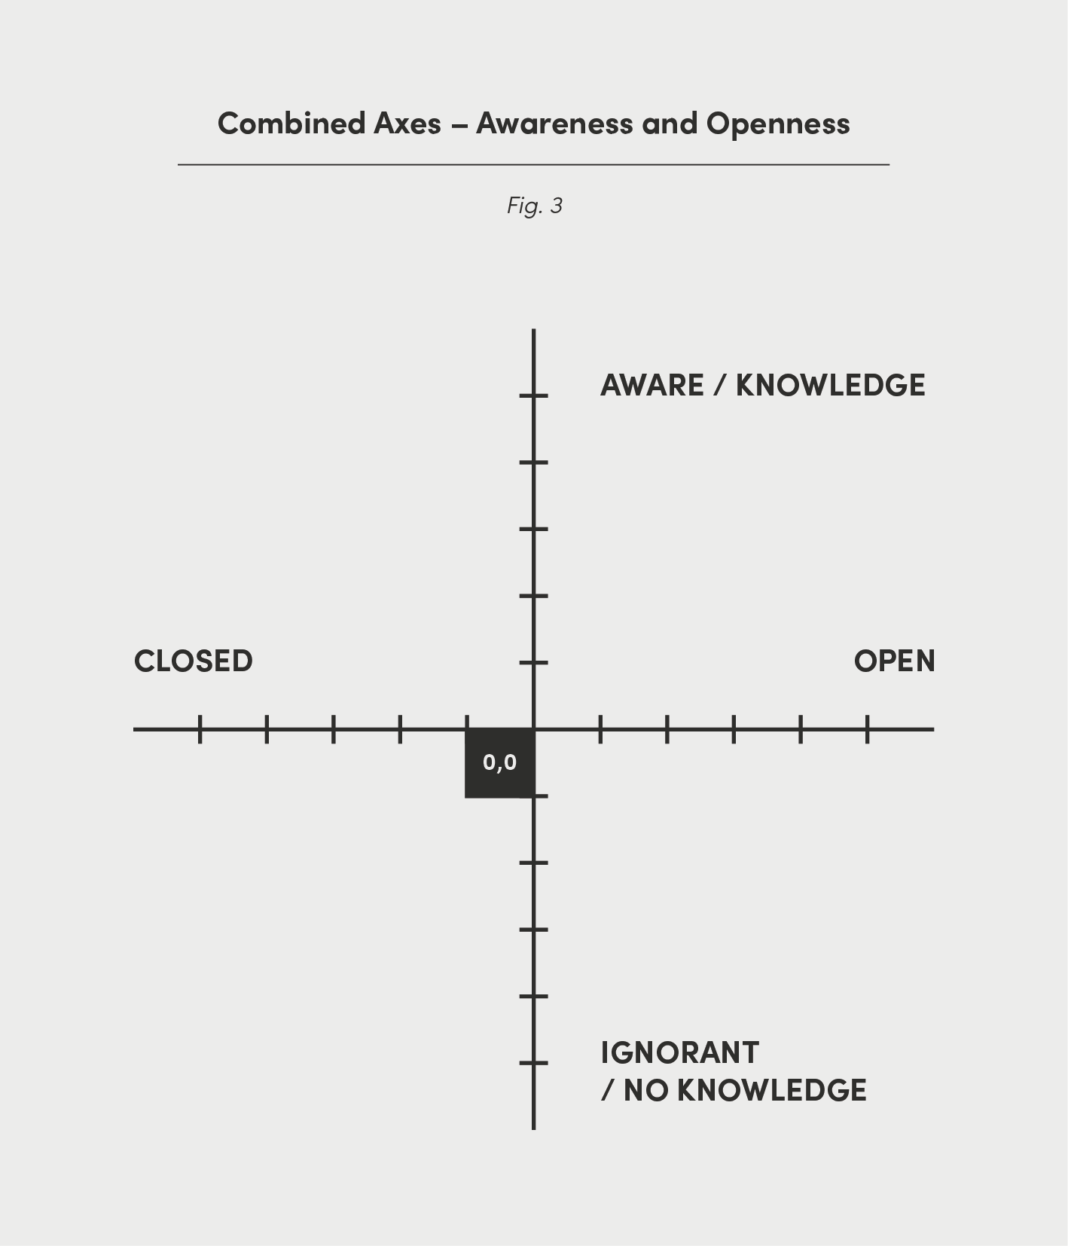
Knowledge + Openness
When we add these two together we get the Matrix:
Notes:
Combining these two dimensions – Knowledge and Openness – into one diagram yields a very interesting result. Hopefully it helps us understand with greater clarity what we need to be saying/doing and how we need to communicate this… Let’s look at it more closely…

Slide 7
The Matrix - alternative
This is a simplified version that avoids numerical scales
It clearly shows the four quadrants
They are divided horizontally into Closed and Open
They are divided vertically into No knowledge and Good knowledge
Less and More indicate how the degree of openness changes from left to right
Vertically Less and More indicate the level of knowledge

Slide 8
The Matrix
4 quadrants (sectors)
A, B, C, and D
Each has its own characteristics…
Notes:
You will see that this (mathematical) model depicts four distinct areas. Let’s call them ‘quadrants’ (or sectors)…

Slide 9
The Matrix – Quadrant A
Characteristics:
Closed toward Gospel
Ignorant of it
Rejecting Message
Possibly opposed to evangelism
Hostile to Christians and church activity
Notes:
We like to begin Quadrant A (bottom left). Here are some of the common characteristics of people in this section. You may recognize some of these characteristics in people you know… There are also many examples of these kinds of people in the Bible…

Slide 10
The Matrix - Quadrant B
Characteristics:
Open toward Gospel
Hungry to know more
Accepting Message
Welcoming Christian activity and engagement
A ripe harvest field
Notes:
People in this quadrant are a wonderful group to be working with because they are hungry to know more about God, Jesus and the Bible. In Bible terms they are fields that are ‘ripe for harvest’

Slide 11
The Matrix –Quadrant C
Characteristics:
Follower of Jesus
Member of a Christian fellowship
Growing in Christ
Active in Church
Sharing God’s blessings
Bringing others to Christ
Notes:
Quadrant C represents the kinds of people we might find in our churches – or meeting together for fellowship in less formal ways, depending on their circumstances. In popular terminology they are followers of Jesus Christ. Hopefully they are growing, they are being discipled, they are active and productive both inside of the church and outside in the community.

Slide 12
The Matrix – Quadrant D
Characteristics:
A difficult group
Have experienced a closeness to Christ but have fallen away
Negative or indifferent toward Christians and Church
Spiritually ‘cold’
Notes:
Showing love and acceptance to people in this sector is possibly the most useful thing we can do. And listen to them, too… It is unlikely to be a mass media approach but one that requires much inter-personal engagement.

Slide 13
Each Quadrant Needs a Different Approach
We cannot effectively reach people in all four quadrants at one time
It is good to make programs that simply build relationships
It is good to help people in practical ways
God made us as body, soul and mind…
Notes:
Four quadrants – four different sets of people – and several subsets within each. Each group represents different needs, different understanding, different degrees of openness to change - and the the Gospel.

Slide 14
Effective Communication
Helps people become more open
Builds relationships, trust and credibility
Helps people understand more and be informed
Recognises Knowledge and Openness are equally necessary
For many people their Attitude may need to change first
People feel accepted, cared for, loved and understood
Full of 'grace and truth' (John 1:14,17)
Notes:
Some say we are successful with our communication when we move people up the Knowledge/Spiritual Awareness axis. That is correct. But once we add the horizontal axis we have to agree that if can can remove barriers to belief and help people to become more open to spiritual truth (i.e. to the right) then we are also being successful. The net result of both vertical and horizontal is a general movement toward the top-right Quadrant C. It is possible that we might have to help people become more open to the Good News first before we get to pass on a lot of knowledge. An open heart will cultivate a good appetite for learning more. We should never think we can ram teaching down people's throats if they are not sympathetic...and willing. 'Grace and truth' was the phrase used to describe Jesus' ministry. Grace is represented by the horizontal element - while Truth belongs to the vertical.

Slide 15
Where People Are
Where on the Matrix would we place the people we are trying to reach?
It is important that we know this
If we don't have a clear idea we may be speaking to the wrong people (possibly those who are believers)
We use x,y coordinates: 'x' denotes where they are horizontally, and 'y' where they are vertically.

Slide 16
Laying a Pathway
When we know where our intended audience is located, we can then plan a series of programs that will eventually lead them to quadrant C (top right).
Note that we may need several programs, each with its own aims - J, K, L, M, N & O.

Slide 17
Part 2: How to use it
© 2021 Frank Gray
Notes:
PURPOSE: To demonstrate that we should not focus solely on imparting Knowledge. We also need to seek ways of building relationships as well as meeting people at their point of (real, felt) need. When we begin to understand where a person is in their spiritual pilgrimage we are in a better position to speak with them in a meaningful way – that they will understand and appreciate.
OUTCOMES:Students will be able to:
1. Draw a Matrix and explain it simply
2. Describe how to position where a specific audience is located
3. Explain why different programs or content are needed according to where audience is positioned on Matrix
4. Describe some basic questions that can be asked to help position a specific audience on Matrix

Slide 18
People, Path and Programs
2.Choose audience
1. Identify where people group located
3. Plot possible program path
4. Identify goal of each specific program
Notes:
There are four diagrams here. The top two are about where people might be located on the Matrix. The first group (left) may be at (-1,-4) while on the right three possible groups are identified: X at (-2,-6), Y at +1,-4) and Z at (+2, +3).
The two lower diagrams show possible program paths. The green path (on left) that would lead a person/group from (-2,-7) to (+3, +3), while the blue section (right) simply helps people move from being moderately resistant(-2) to being fairly open (+3)

Slide 19
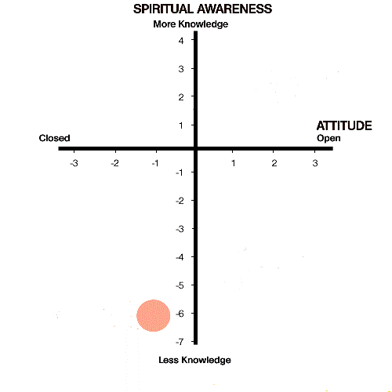
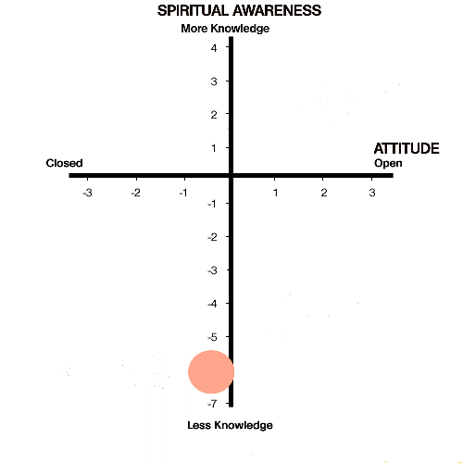
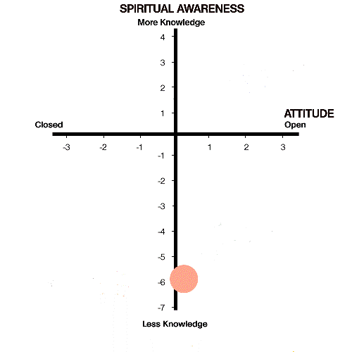
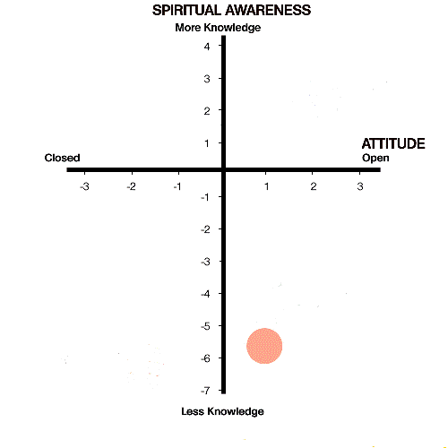
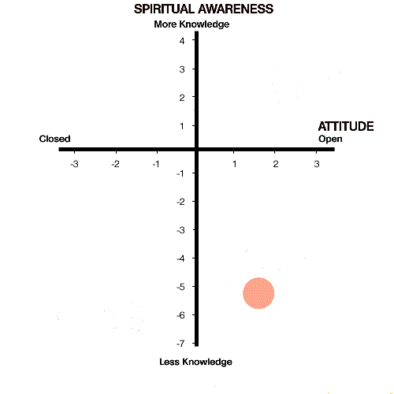
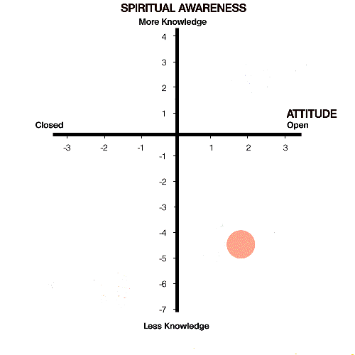
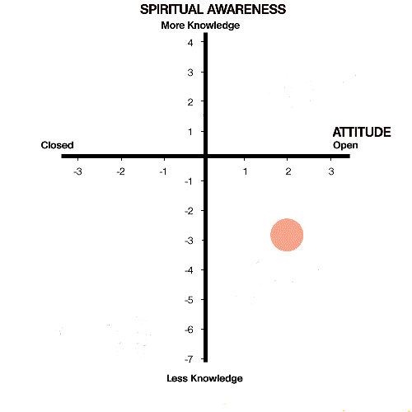
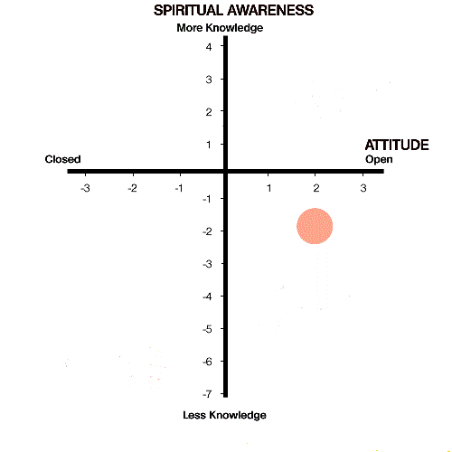
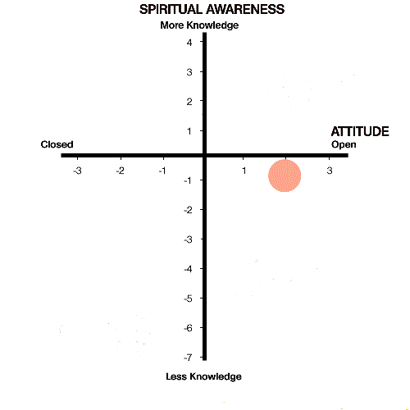
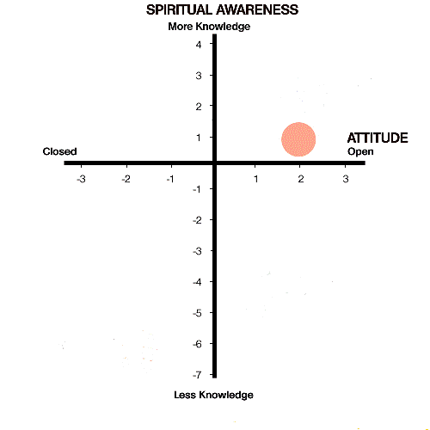
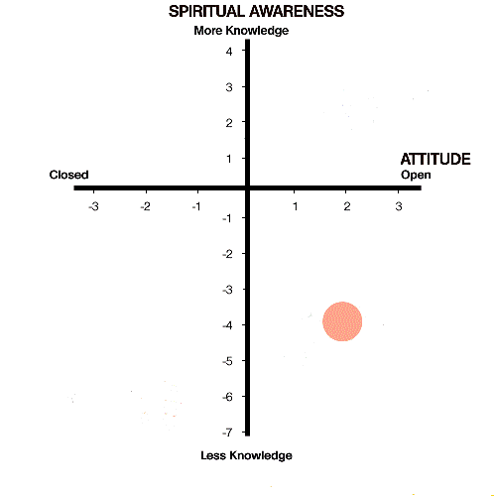
Laying a Pathway
Notes:
This simple animation illustrates the possible pathway a person (or group) might take in moving from a position of closed disbelief to becoming an enthusiastic follower of Jesus. (I once encountered a pastor in Asia who, 10 years earlier, had been the most wanted criminal in the capital city, but who got completely turned around by his encounter with Jesus Christ! This could have described his pilgrimage.)

Slide 20
Pathway and Programs
Discipling
Reaping
Watering
Sowing
Notes:
This colourful pathway is used to unpack the process in greater detail. There are four recognised (and biblical) stages- Sowing, Watering, Reaping and Discipling. Each coloured ellipse in the pathway represents a different program within the overall strategy. It is prepared for an audience that is at a specific point in their spiritual journey. The first (green) one J is designed to move people to the right where it delivers audience to program K. Both of these (as well as L) have little specific content apart from raising awareness of a loving God. Their primary purpose is to bring about openness and put them in a position where they want to learn more. The 'seeds' are then watered (M) to the point that program N (possibly a very different kind of person-to-person ministry takes them through the process of taking the step of faith. Program O continues that process with appropriate discipling as the new convert is nurtured within a Christian fellowship.

Slide 21
A common problem:
We say we are reaching people here
But in reality we are speaking to people here..
…or here
Notes:
Now we come to address some hard realities... Some very bold claims are often made about 'how many people have been reached with the Gospel'. The key word here is 'reached'. We might debate what we mean by this term - but as messengers who are concerned about the impact of our communication we must surely be concerned that what we deliver is (a) understood and (b) produces the effect of drawing people closer to Jesus. The sad reality is that we are often deceiving ourslves. We think we are speaking to a specific group of people but, alas, they do not understand what we are saying, they are not interested in it anyhow - and they simply switch off, and will never return again. This diagram illustrates efforts to reach a group at (-2-,-6) - but it is missing the mark completely.... Why?

Slide 22
BUT…
This Matrix may not reflect the contemporary world (Why not?)
There is a rising tide of scepticism
More and more people don’t have Awareness of Supreme Being
They deserve much closer attention
They also need to be better understood – and listened to!
Therefore….
Barna Group Unchurched research in USA 2011 (See www.unchurched.com)
77%
73%
63%
60%
‘Christians’ declining →
‘Outsiders’ increasing →
37%
40%
23%
27%
Age 61+
Ages 42-50
Ages 18-41
Ages 16-29
Notes:
Now we introduce another complication which originally impacted the western world but through globalisation is likely to impact most industrialised civilizations. Post-modernism and materialism have worked hand-in-hand to produce a culture of disbelief and scepticism in traditional religions. The result is that fewer and fewer people have an awareness of a Supreme Being (=God). The numbers of people who now describe themselves as Atheist or Agnostic has grown at an alarming rate (Note the 40% of 16-29 yr-olds), assisted in part (in the west) by educational systems that have sought to eliminate the impact of faith on contemporary life.
This means that a lot more work needs to be done in the lower parts of the Matrix.

Slide 23
The Matrix Extension
6
5
4
3
2
1
-3
-2
-1
1
2
3
-1
-2
-3
-4
-5
-6
Vague Awareness & belief in God God Framework
Experience of emptiness
No God Framework
-7
-8
-9
-10
Notes:
The original Matrix was based on work done by James Engel in the mid 1970s but it is now an outdated model. The world has moved on. With that in mind a revised Matrix now includes stages - from -7 to -10 on the vertical axis. The process begins now with addressing those who are so materialistically conditioned in their worldview that they have no concept of a Supreme Being, a Creator, a God who loves them. Nothing could be further from their understanding...! Moreover, they really are not interested in knowing... So what can we do - as communicators?

Slide 24
The Complete Matrix Extended (TGMX)
Continuing growth
Aware of Responsibilities
Knowledge of God’s Kingdom
Knowledge of Adoption
Experience of God’s Love
Initial knowledge of Father God
6
5
4
3
2
1
CLOSED
OPEN
-3
-2
-1
1
2
3
Grasps Implications/Aware of Cost
Aware of Personal Need
Aware of Basics of Gospel
Interested in Jesus
Aware of Jesus
Wonders if God can be known
Vague Awareness/belief in God
God Framework
Experience of Emptiness
No God Framework
-1
-2
-3
-4
-5
-6
-7
-8
-9
-10
Notes:
The revised Matrix now looks like this. It has codename 'TGMX' - The Gray Matrix Extended. The simplified Matrix as described earlier can still be used but it is recommended that for any serious work, particularly in the materialistic world, the TGMX be used.

Slide 25
Analysis
Actual
Audiences
Intended
Groups
What groups are your programs currently aimed at?
What audiences are they actually attracting?
Plot them on the Matrix
Are there some gaps? (if so – where?)
How will you fill the gaps?
Notes:
Here is a very quick example of how we might determine how well suited our programs are to their intended audiences. On the left we see where three groups are located on TGM - but on the right it shows where in fact our programs are 'landing'. Most are only appreciated (and understood? by those who are already believers. All programs assume that people will want to listen to the Gospel when in reality many do not...

Slide 26
Summary of Matrix Uses
1. Helps us understand where people are at in their spiritual journey
2. Helps us look at our programs critically as we see differences between intended and actual audiences
3. Helps us plan our own strategy with greater understanding
4. Helps us plot progress of people and groups
5. Helps us appreciate more the importance of establishing relationships
Notes:
Here is a summary of four of the basic uses of the Gray Matrix. These are all related to operations. In addition to these primary uses it also has great value in training and orientation.

Slide 27
1. HOW TO KNOW Where people are at
Meet with your team
Discuss together how well you know your audience
Use a Matrix blank sheet
Where are people on the vertical scale (knowledge)
are they believers? YES/NO
how much do they know?
Are they open to change? YES/NO
2 things we need to know:
1. How much they know and understand about the Gospel
2. How open are they to change
Tools:
A. Useful questions to ask
B. A blank Matrix sheet for download
Notes:
Now we look more closely at how we can use the Matrix - practically. Here a very basic approach is suggested for a team approach. You will need a blank Matrix to do this exercise. This addresses both the x- and the y-axis with two basic questions. The next page looks at some possible probing questions that might help.

Slide 28
Questions for vertical (knowledge)
Did you know that:
Jesus is a historical figure Y/N
Jesus was a good man Y/N
Jesus died on the Cross for our sins Y/N
Jesus rose again from the dead Y/N
Jesus has ascended into heaven Y/N
Jesus will come again Y/N
Where do we come from ?
Why are we here?
Is there a God?
If there is a God what does he want?
What happens to us after we die?
Did we evolve or are we created?
Notes:
Here are some possible questions that will shed light on how much knowledge of the Gospel that people may have. These are given as practical examples - but can be adapted to the culture and religious background of the people. Openness is addressed in the next slide...

Slide 29
Questions for horizontal (openness)
How satisfied are you with your life at present? (1-5)
What would you like to change?
How do you feel
About God?
About Jesus?
About Christian belief
About Christians?
I would like to know more about Jesus Y/N
I would like to study the Bible Y/N
I would like to go with a Christian to church Y/N
I am happy with what I believe now Y/N
I am curious to know more about Christian faith Y/N
Notes:
Here are some suggested questions that will indicate horizontal positioning.

Slide 30
2. HOW TO KNOW if your programs are hitting the right audience
Each program should have a target audience in mind
We can define the approximate centre of this audience by positioning it on TGM
Name the target audience and position it on TGM using TGM blank
On the same sheet locate the position of target audience.
Complete honesty will be required here so that a true comparison can be made between (1) the target audience of the program and (2) the position of the program itself.
Use Question sheet to determine how to position the program.
Notes:
This looks at the suitability of our existing programs. Are they reaching the intended audience? For this to be helpful we need to conduct this study carefully and with complete honesty...

Slide 31
3. HOW TO PLAN your own strategy
Each program should be part of an overall strategy
We need programs to cover different sections of the pathway
Plan programs that each have a specific audience defined by (x,y) coordinates.
Listeners will gravitate towards programs they understand and enjoy
See Pathway and Programs slide (#16)
See Media Roles (Radio Programming Roles) and Fitting the Jigsaw Together (in Radio Programming Roles)
Notes:
It is important that we know the process. When people show an interest in Gospel they will grow in their understanding. As they grow they will need something more - or something bigger. It is just like finding clothes to fit our growing children.
But while they are growing others will also be starting their journey to faith. This means we still need to have a program for beginners - but also for those who move on. And so the process continues. Soon we shall need three, and more. We also need to have programs for new believers - as well as those who are more mature Christians.

Slide 32
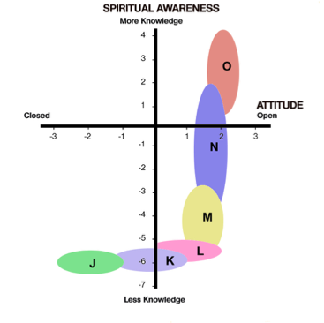
4. HOW TO PLOT progress of people and groups
The Matrix can be used to plot the progress of individuals in their spiritual growth.
First you will need to conduct a baseline - where they are NOW. Then you will need to conduct the same assessment in 6 months - or a year - and at regular intervals.

Slide 33
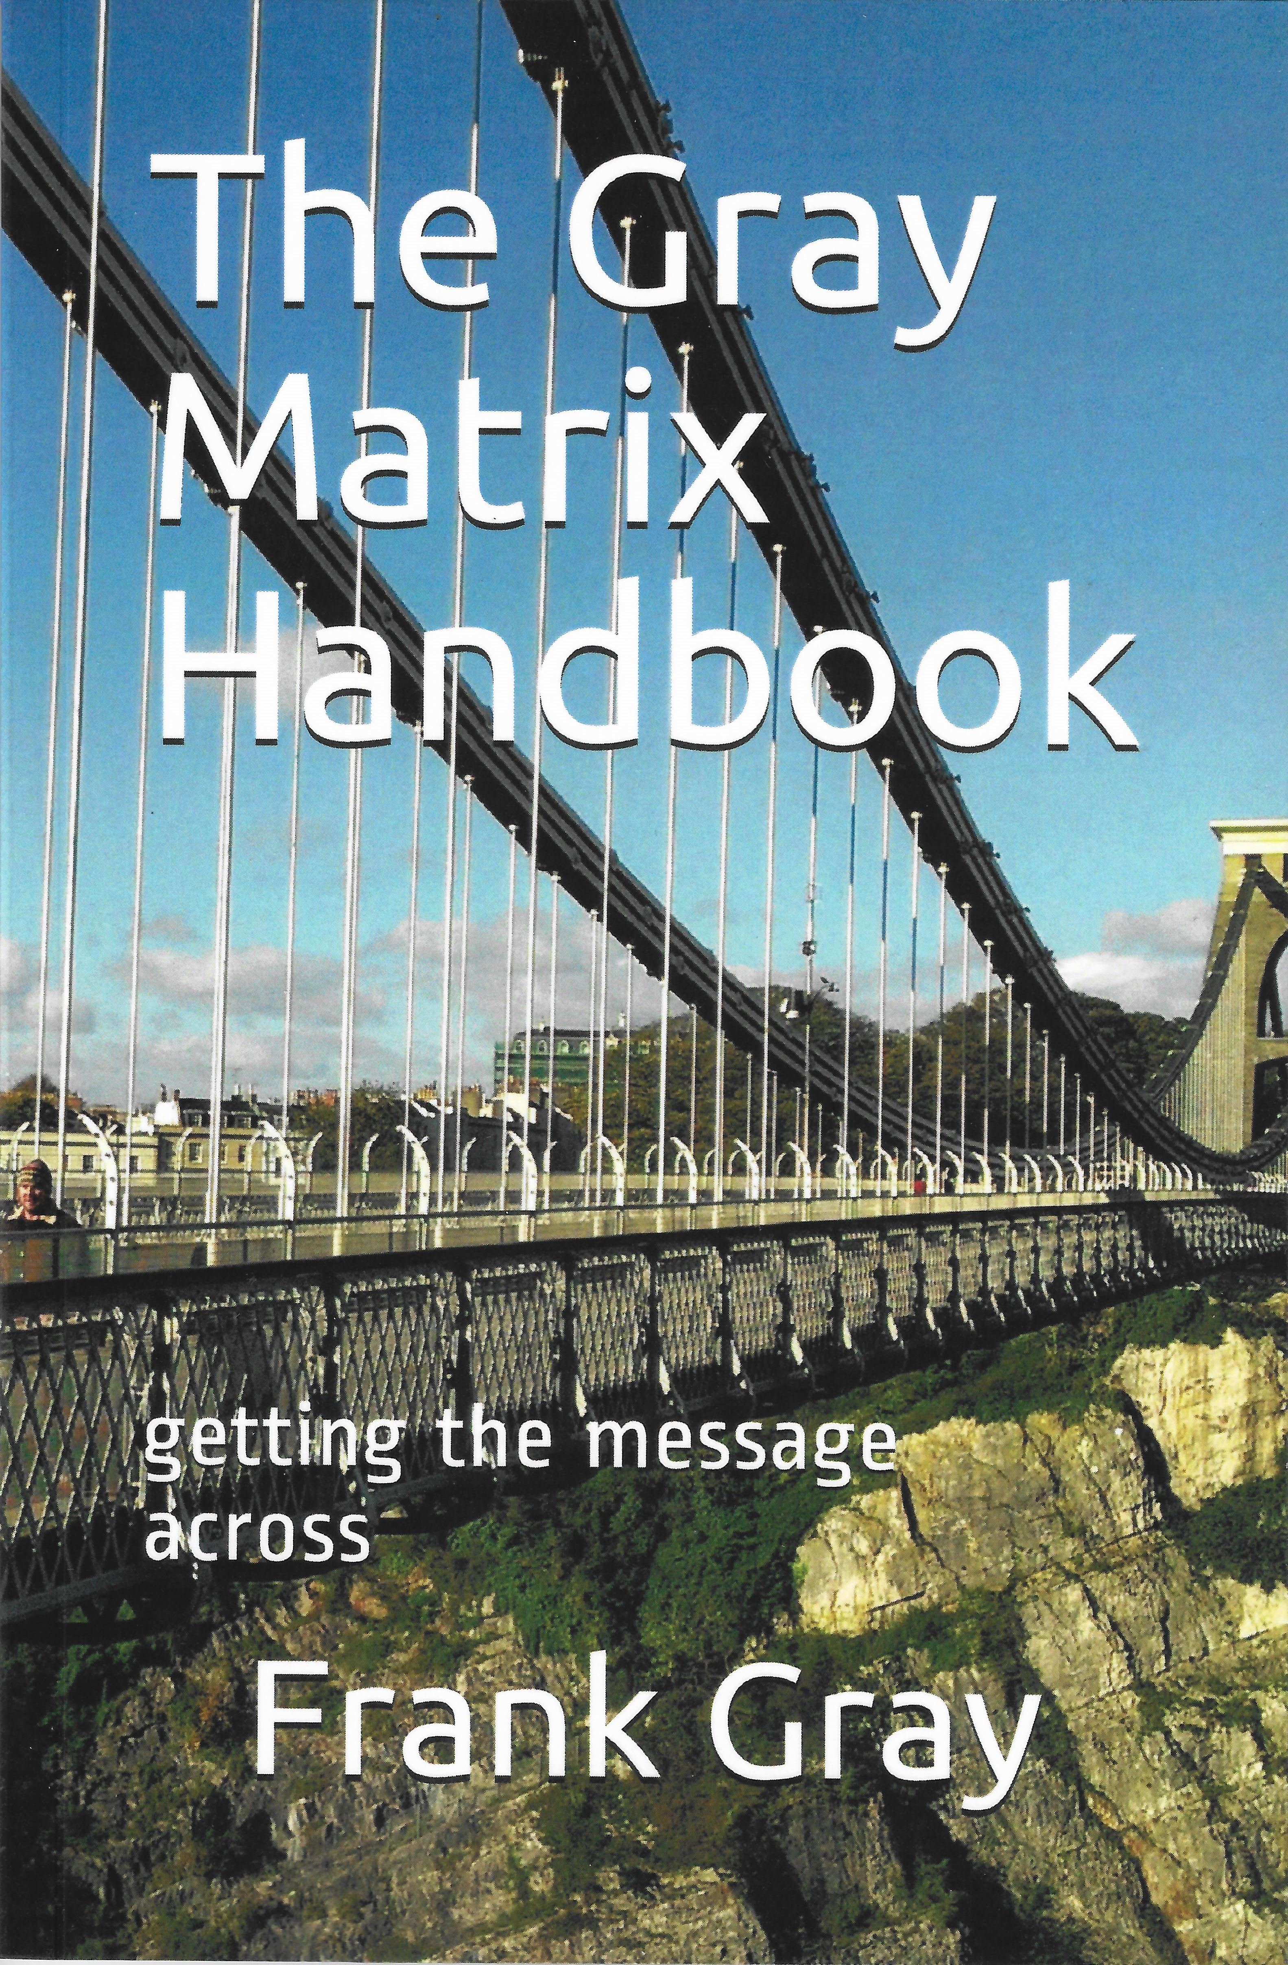
Further Info - Copyright
Stay in touch:
web-site www.thegraymatrix.org
Facebook
Download copies of
the Gray Matrix PPT presentation
the booklet (at issuu.com/frankgray)
Buy a copy of The Gray Matrix Handbook – paperback or Kindle –from Amazon
Copyright
You are free to use any of the Gray Matrix materials BUT you will need to give due attribution to the source
Notes:
This is just the beginning. You may continue to enhance your understanding of TGM by a variety of methods: (1) the TGM web site; (2) the booklet for download from ISSUU; (3) downloading copies of a blank Gray Matrix so that you can begin using it.
You may also want to share what you have learned with others. If so you may request a copy of this presentation or download a version version from the web.

Slide 34
Auto-cue script
This short video explains the essential details of the Gray Matrix
First, what is it good for?
Firstly, for finding out where people are in their spiritual pilgrimage
Secondly, for diagnosing how well our current ministries are performing. Are they hitting the mark?
Thirdly, for planning a balanced set of ministries and
Fourthly, for understanding the importance of relationships in communicating the message

Slide 35
We need to begin with our audience… How much do we really know about them? Are they open to change? Do they know about God? If so, how do they feel about God? or about Jesus? Or the church? What problems do they face?
Here is a simple scale which denotes a person’s knowledge of the gospel or spiritual awareness… Starting at the bottom we find is no awareness of God. Then we go through various stages of increasing awareness, to personal knowledge and experience of God at the top. We refer to this as ‘the vertical scale’

Slide 36
The ‘horizontal scale’ indicates their openness towards the gospel. From CLOSED on the left to OPEN on the right. It does not depend on their knowledge. It addresses feelings and experiences, and it reflects relationship and trust. It is conversational in style.
When we add the vertical scale to the horizontal scale we get the Gray Matrix.
You will see that the Matrix is made up of four areas or quadrants A, B, C,&D. Each has its own characteristics. Let's look at these more closely….

Slide 37
Quadrant A. Characteristics of people in this quadrant: they are closed to the gospel, they are unaware of it or rejecting it, they are possibly opposed to evangelism, and hostile to Christians or church activity.
Quadrant B: here they are open toward the gospel, they are hungry to know more, they are accepting of the message, they are welcoming Christian activity or engagement. In Bible terms they are ‘a ripe harvest field’

Slide 38
Quadrant C: This is where we want people to arrive as followers of Jesus, as members of a Christian fellowship, wherever that is possible. They're growing in Christ, active in the church, they are sharing God's blessings and bringing others to Christ, too.
Then we have quadrant D: a difficult group. They have experienced a closeness to Christ most probably, but they have fallen away. They are negative or indifferent to the gospel, they are spiritually cold.

Slide 39
Now here's the important point: each quadrant is quite different and needs a separate approach. We cannot effectively reach people in all four quadrants at the same time.
It is good to make programs that simply build relationships. It is good to help people practically as an expression of God's love. God made us as body, soul and mind.

Slide 40
Now, we look at some of the evidences of effective communication. If we look at this diagram we see there in the bottom left hand corner there are three arrows:-
the vertical one represents a person’s understanding,
the horizontal one, pointing to the right, indicates their openness.
the red one is the general overall movement or direction of growth –
Effective communication, opens up conversation and helps people become more open. It builds relationships that are trustworthy and credible, it helps people understand more, it recognises knowledge and openness are equally necessary. For many people their attitude may need to change first. That's important to recognise. People feel accepted, cared for and loved and understood.

Slide 41
And now we come to the interesting part, determining where people are at and how we enable them to get to quadrant C in the top right. You see that we have three sets of people in this illustration – the red one at X, the green one at Y, and the blue one at Z …. X with closed attitude minimal knowledge or spiritual understanding. Y with an open mind but not much knowledge, and Z a believer who has an interest in deepening his faith
How do we help these people move? We lay a pathway. it is made up of various programs each suited to where a person is at in his faith journey... J, K, L, M, N and O. We shall explore this in greater depth in Part 2 which is to follow.

Slide 42
That is the end of Part1... except to recommend looking at the website and also the book The Gray Matrix Handbook. It is available on Amazon as a paperback, or Kindle ebook. Part 2 will follow later ...

